Slide 1


Git and GitHub
Academic year 24-25
Week 1
Lab 1

Slide 2

What is Git
Git is a free and open source distributed version control system designed to handle everything from small to very large projects with speed and efficiency.
Git is a software tool to version control your code.
Other web based/hosting GUI’s for git include:

Slide 3
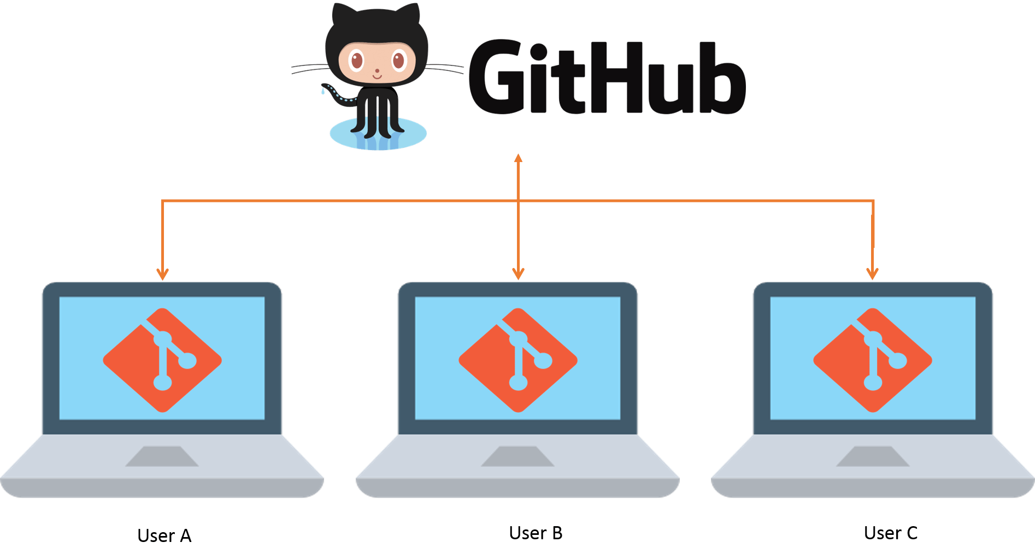
GitHub
GitHub Is a web based graphical user interface (GUI) for git. It allows the git server to be hosted on GitHub website server and add many additional features for smoother collaboration.

Slide 4
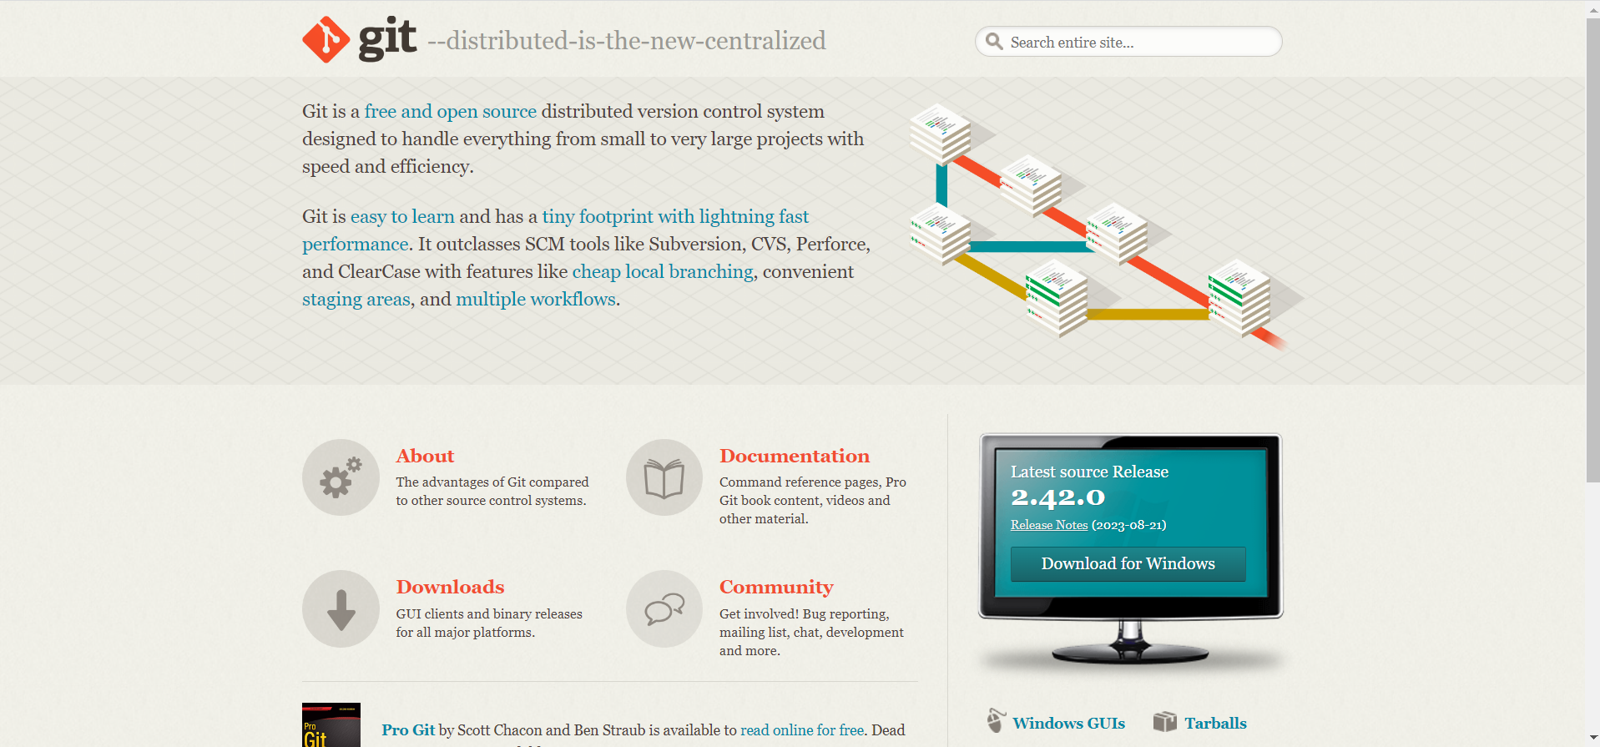
How to setup Git and GitHub
Setup Git in your PC
https://git-scm.com/

Slide 5
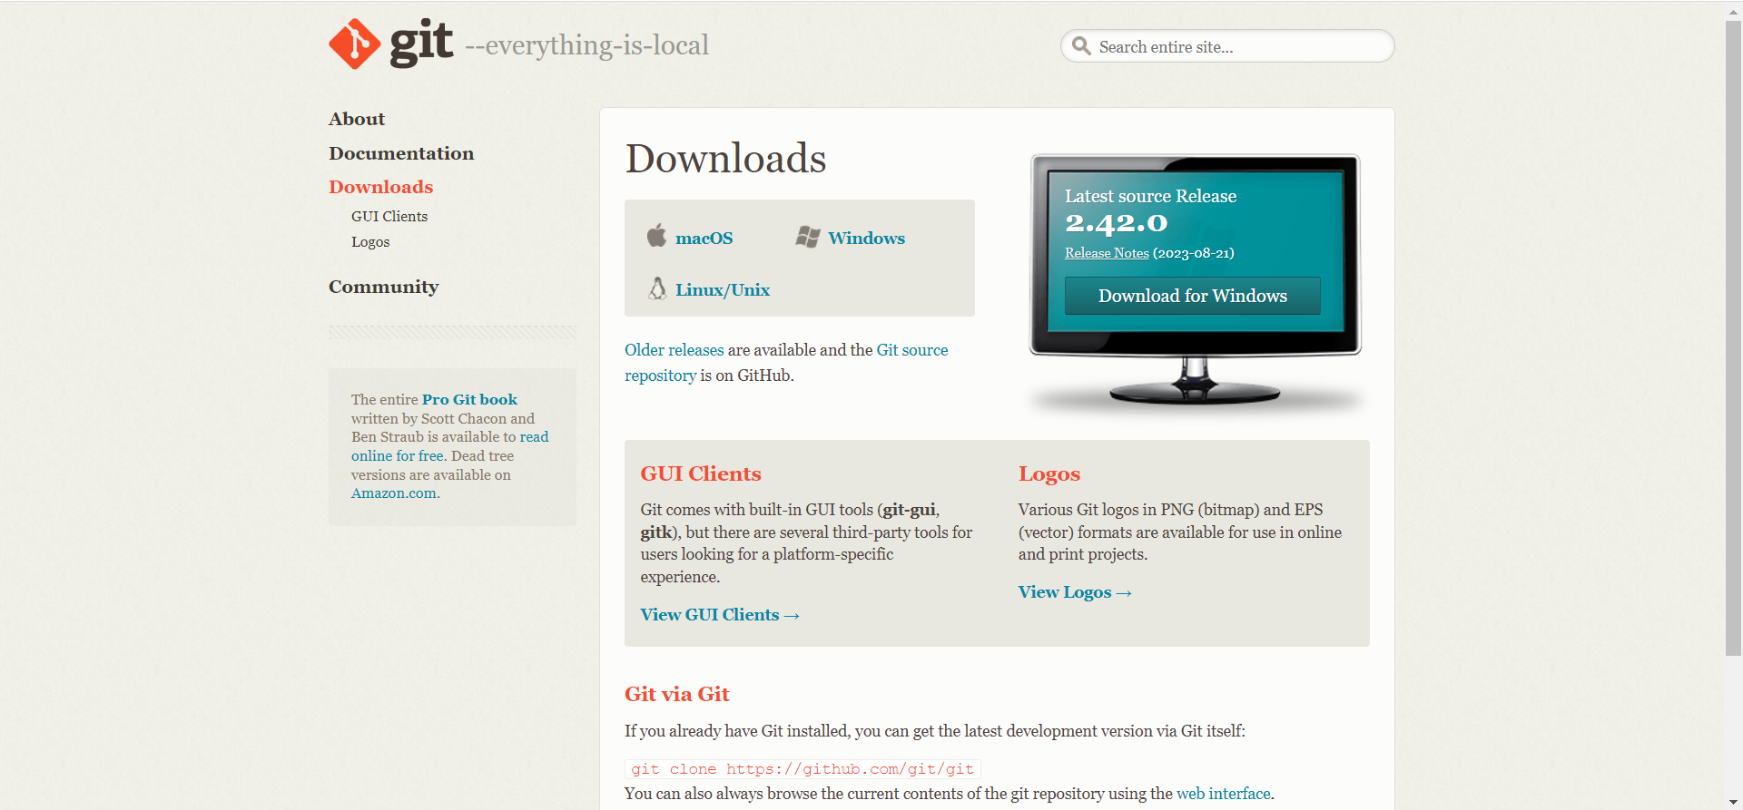
Choose your Operating System

Slide 6
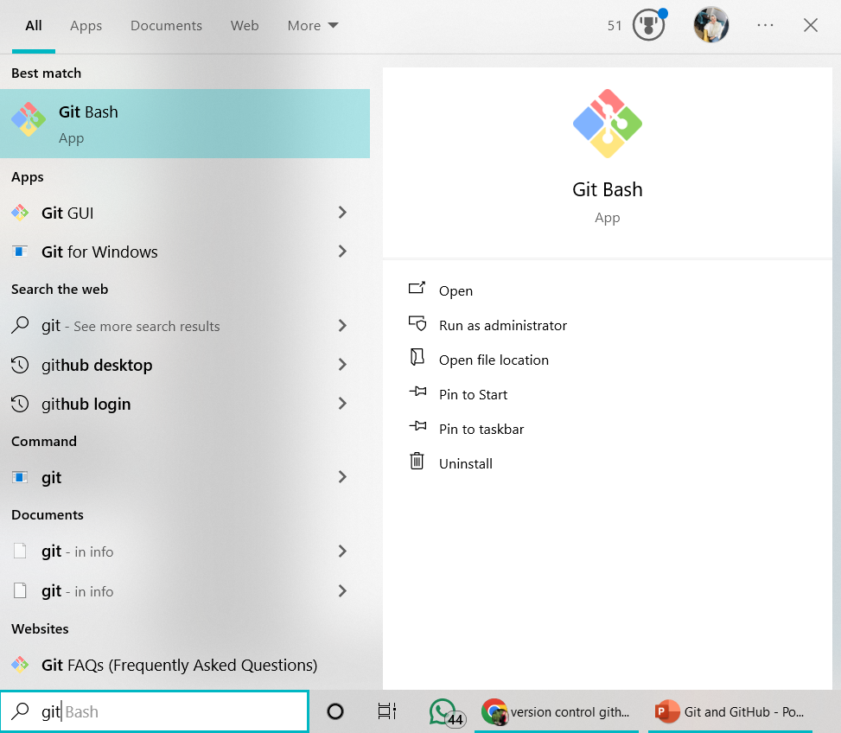
After setup git open Git Bash

Slide 7
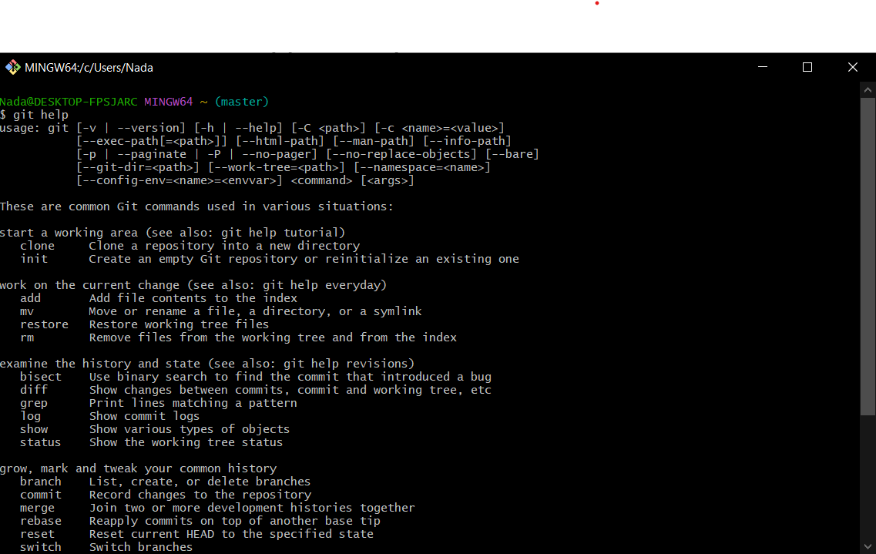
Write command git help

Slide 8
Git commands
git init command creates a new Git repository.
git add a command that allows you to stage individual files, or all files in the project directory at once, preparing them to be staged.
git add file name Ex: git add section1.py => this add individual file.
git add . => this add all files .
git commit change point or "save point". It is a point in the project you can go back to if you find a bug, or want to make a change.
Can we say it is a version or backup you can return to stable version.
Ex:- git commit –m “write your message”

Slide 9
Git commands
git status displays the state of the working directory and the staging area.
git push command is used to upload local repository content to a remote repository.

Slide 10
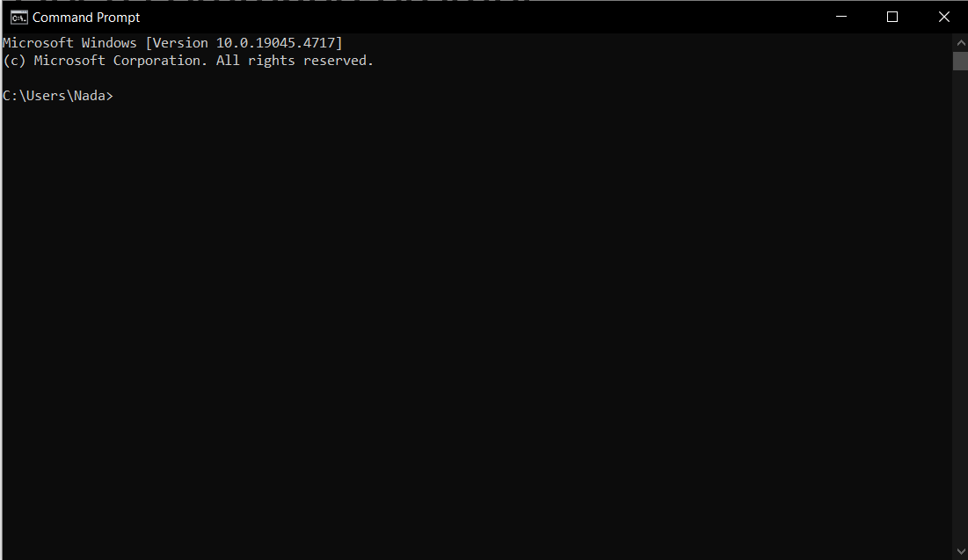
Open command prompt
As you can see direction in C Partition and I make file in D partition and I want to go there

Slide 11
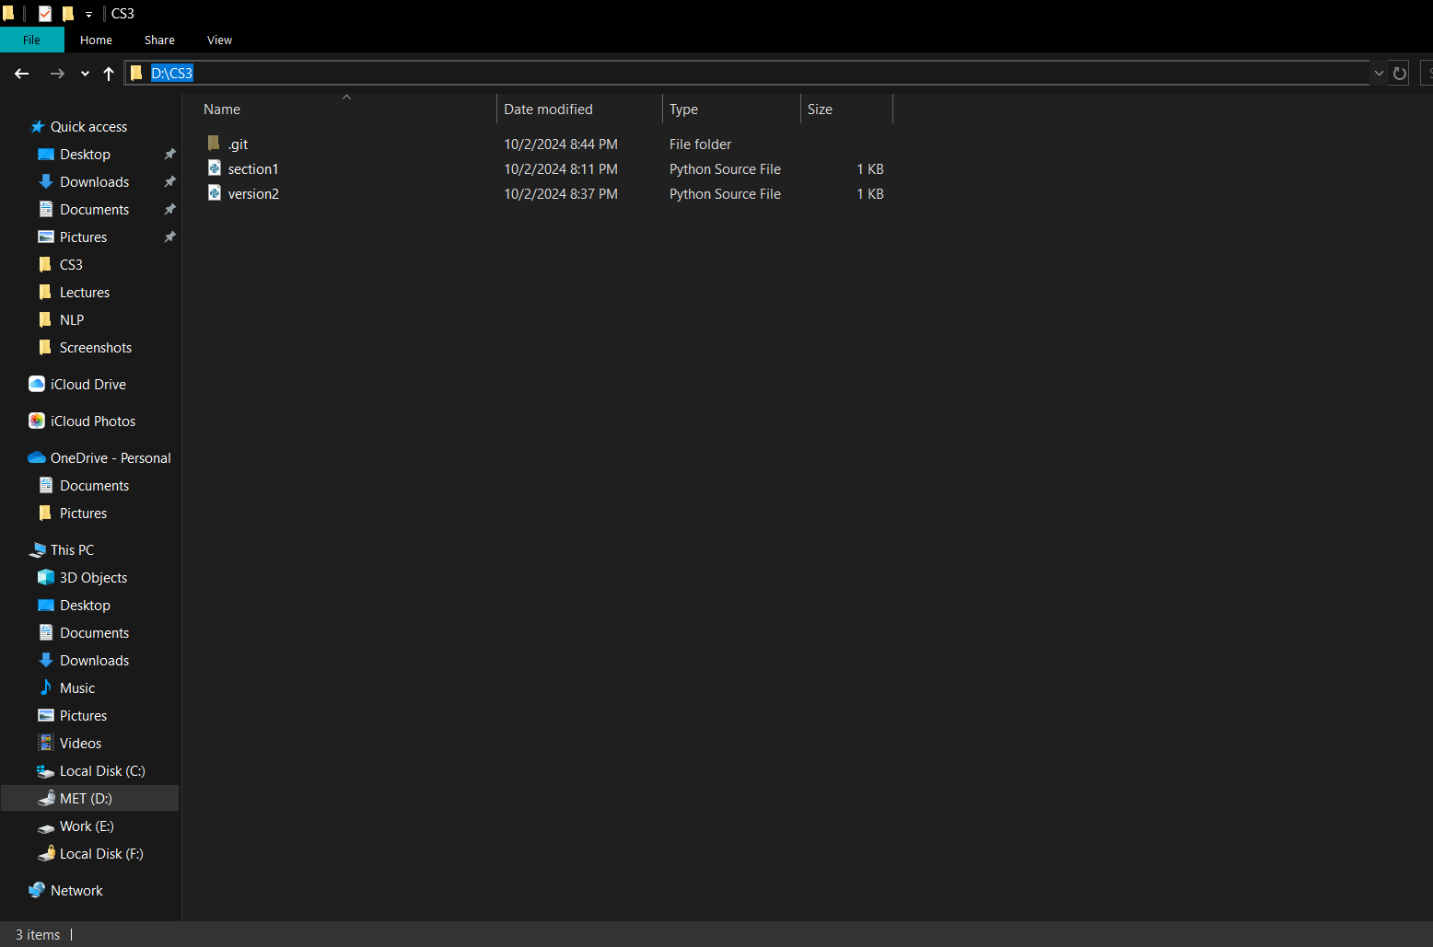
Copy this directory

Slide 12
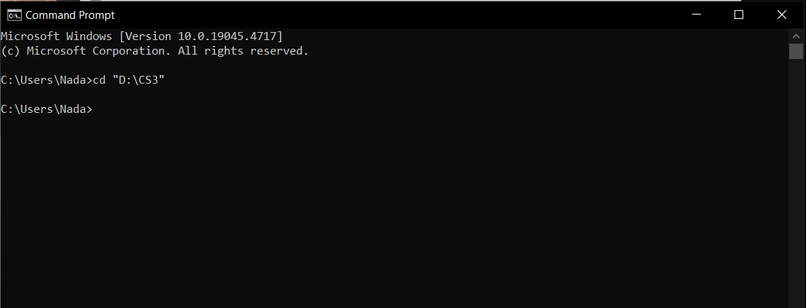
Cd is Change Directory
Write the command
cd “Directory”

Slide 13
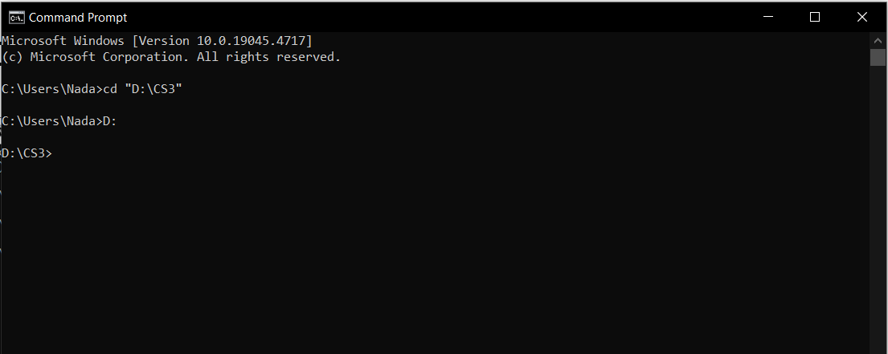
Now I am in the folder I want to use in git
After this write the partition name D:

Slide 14
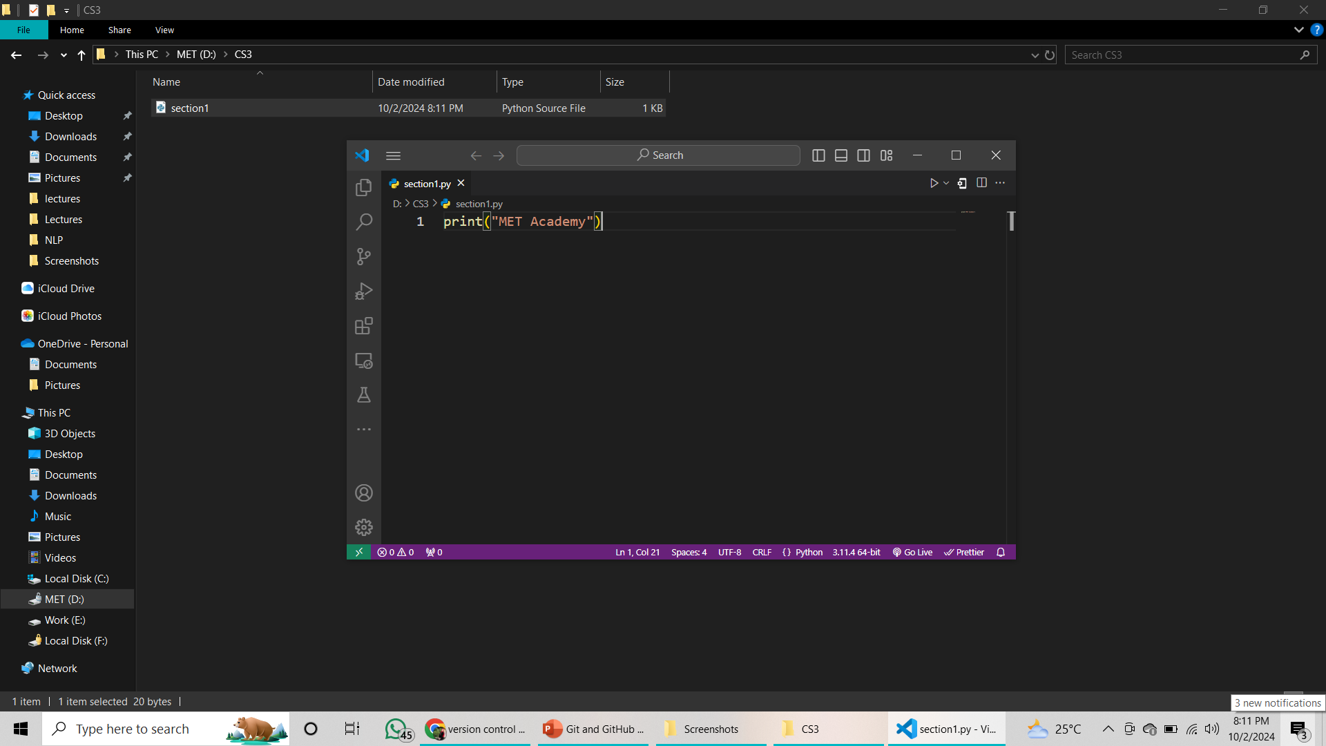
Made a file with python code and save code

Slide 15
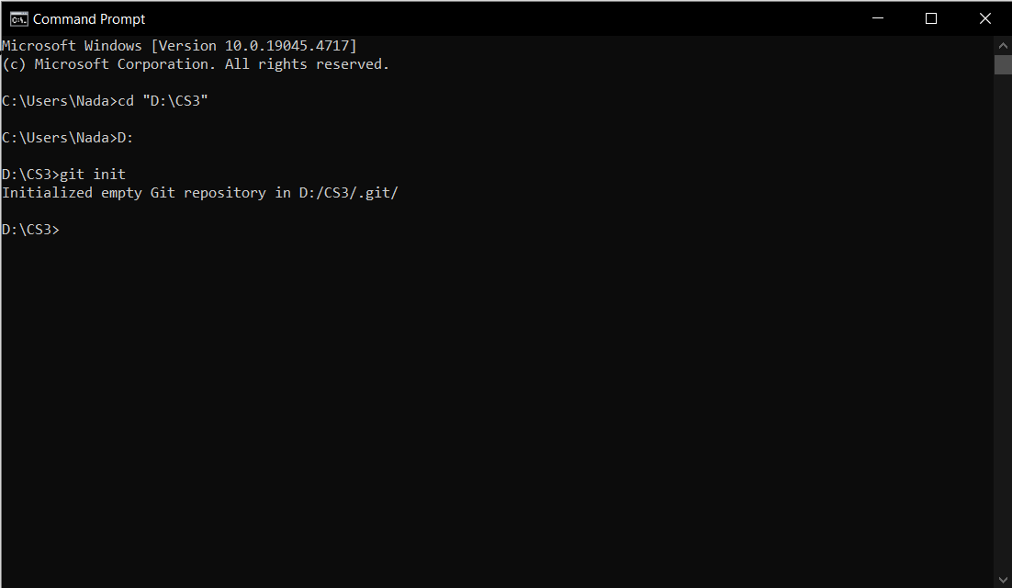
First command is git init

Slide 16
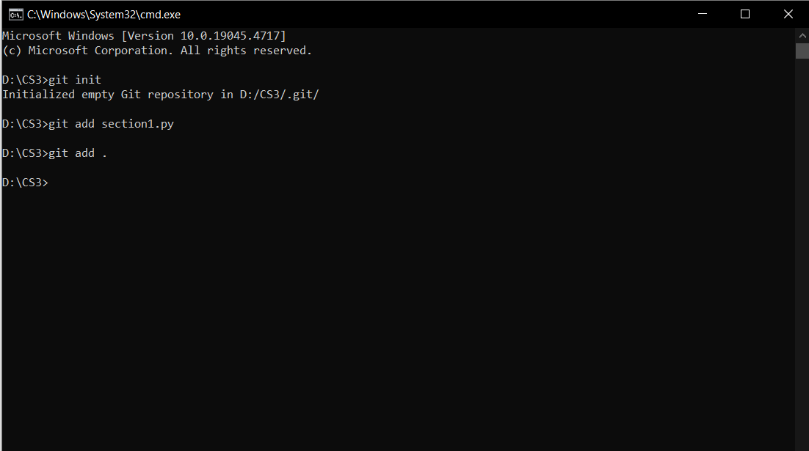
Now I want to add file name “section1.py” can use any of this git add section1.py => add this file only git add . => add all files
You can only use one of these

Slide 17
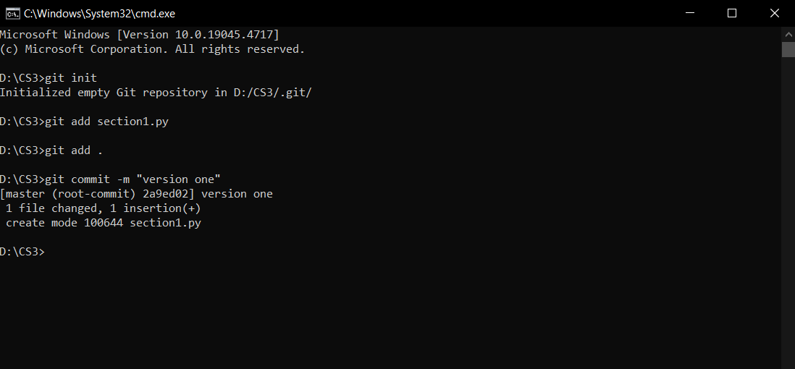
Write command git commit –m ” write your message”

Slide 18
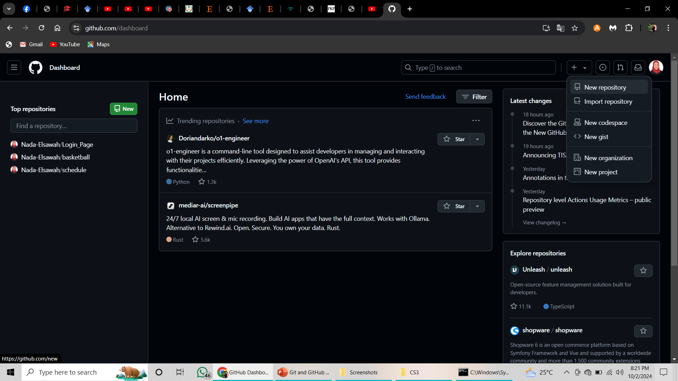
Open GitHub and make new repository

Slide 19
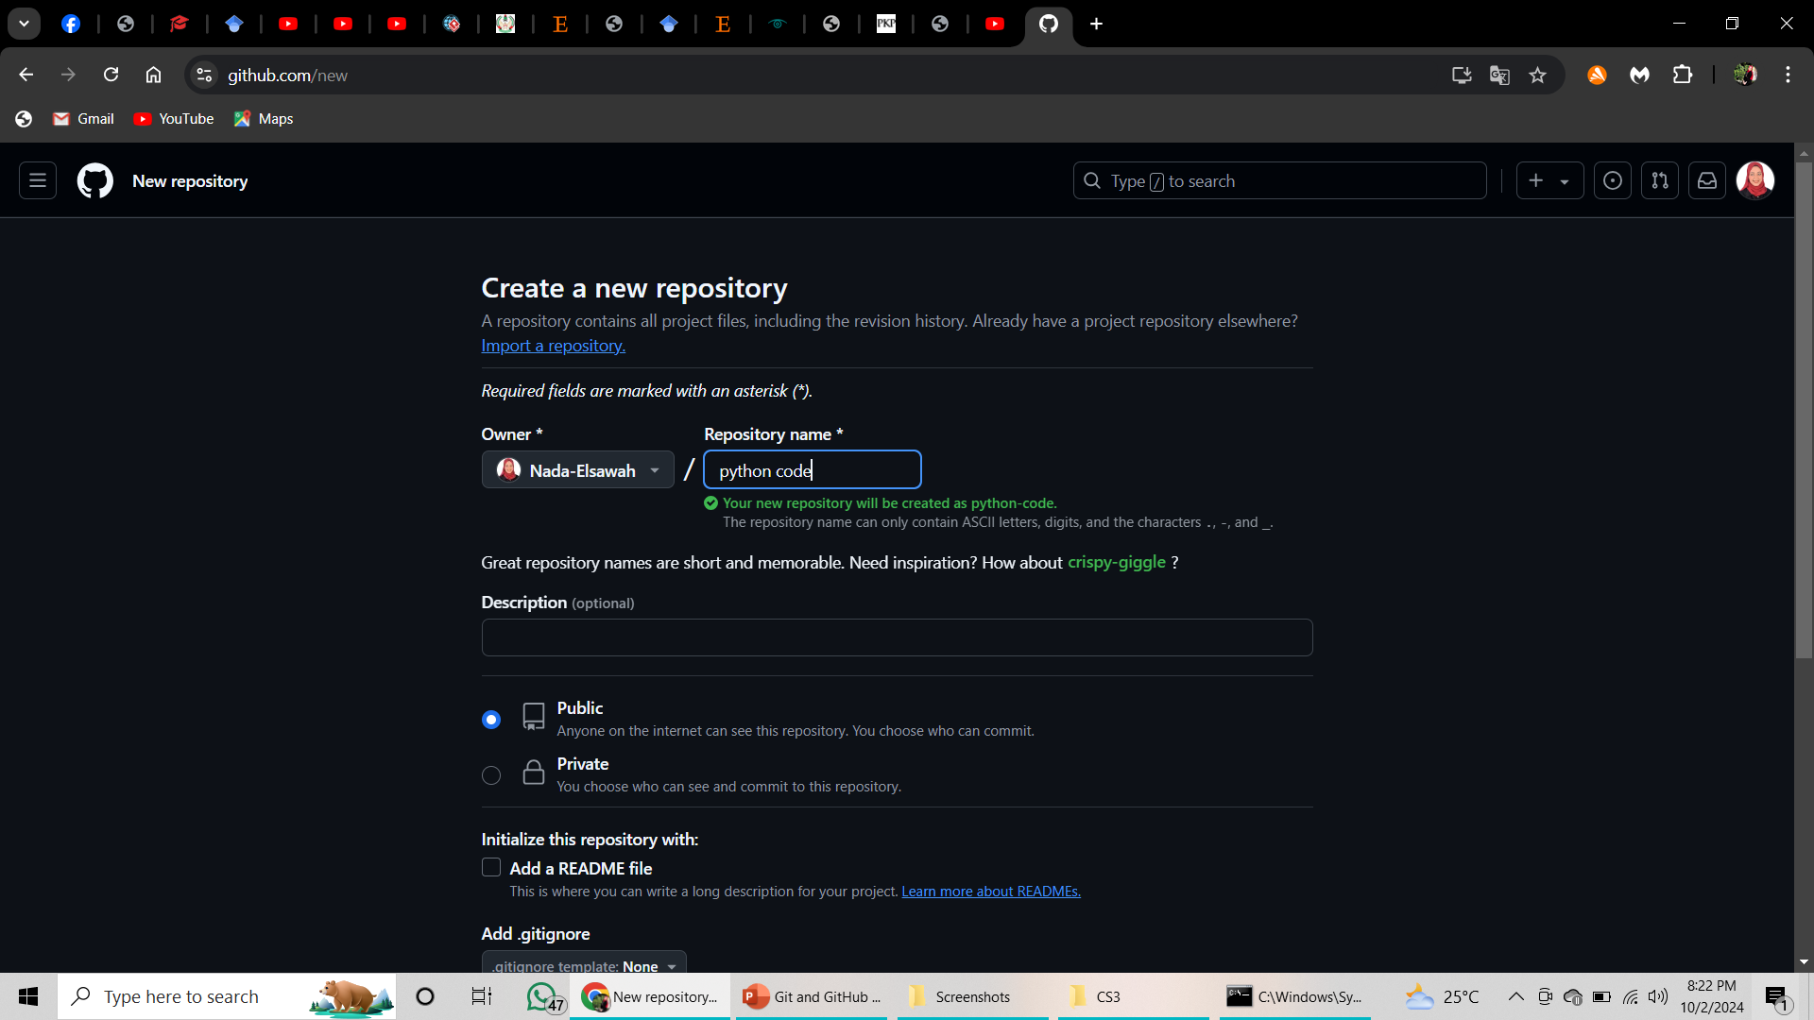
Add repo name
Choose your repo is public or private

Slide 20
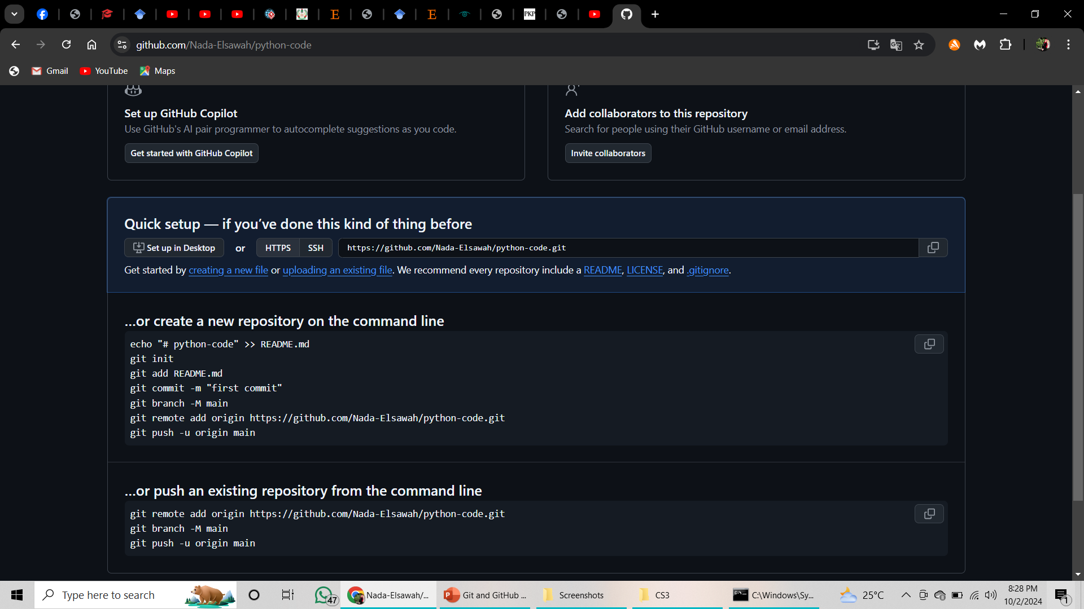
Now we need to push file into GitHub

Slide 21
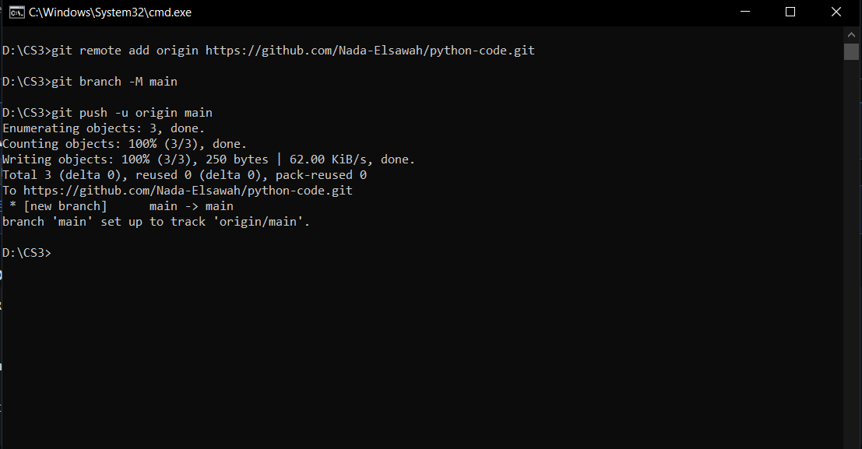
Add file in GitHub
1) git remote add origin https://github.com/Nada-Elsawah/python-code.git
2) git branch -M main
3) git push -u origin main

Slide 22
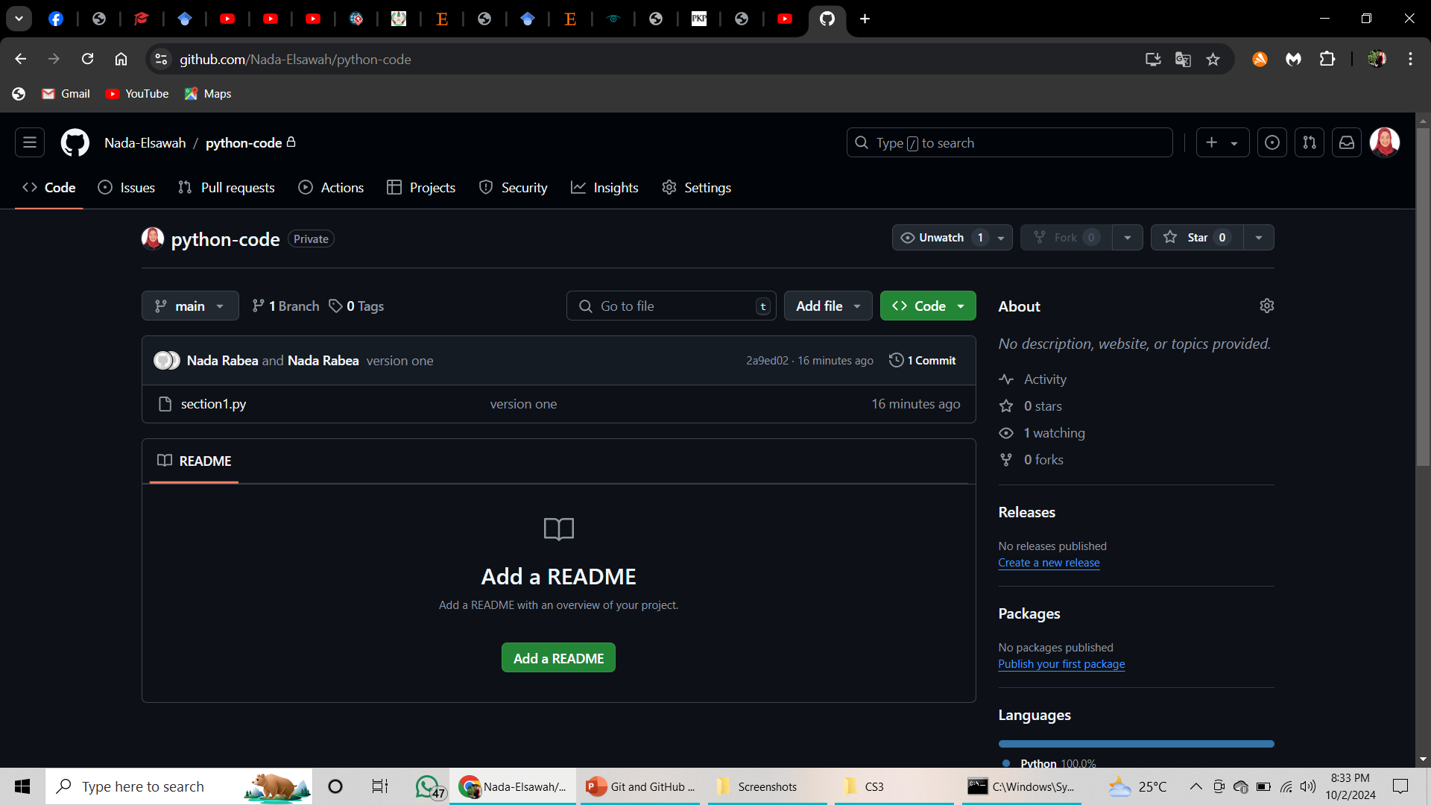
Make refresh in your repo the file will appear

Slide 23
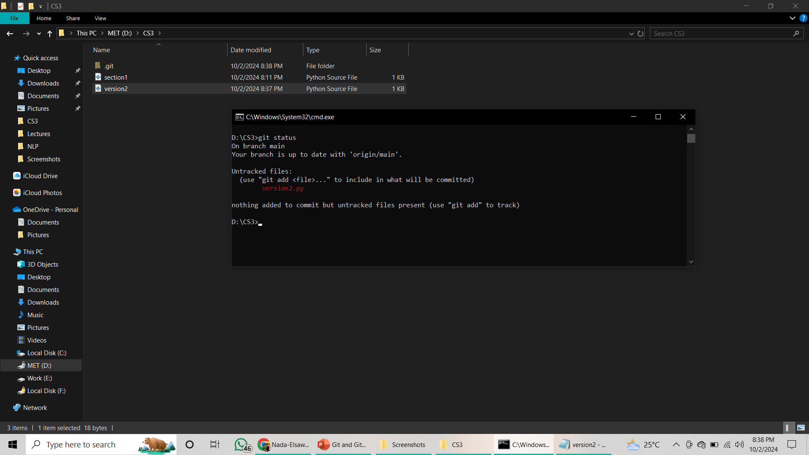
Now we add a new file named version2.py

Slide 24
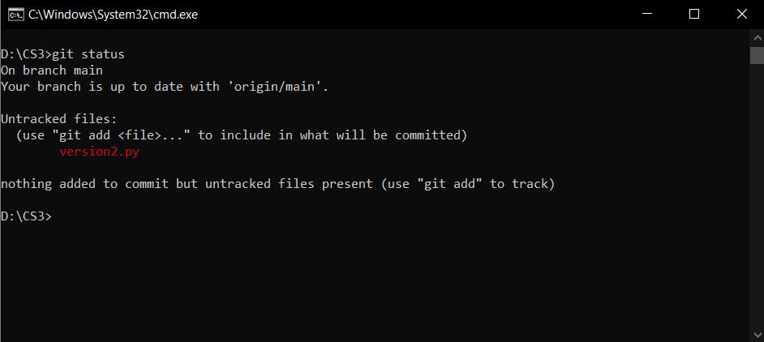
We use git status to show if we have a changes
git status to see files and status

Slide 25
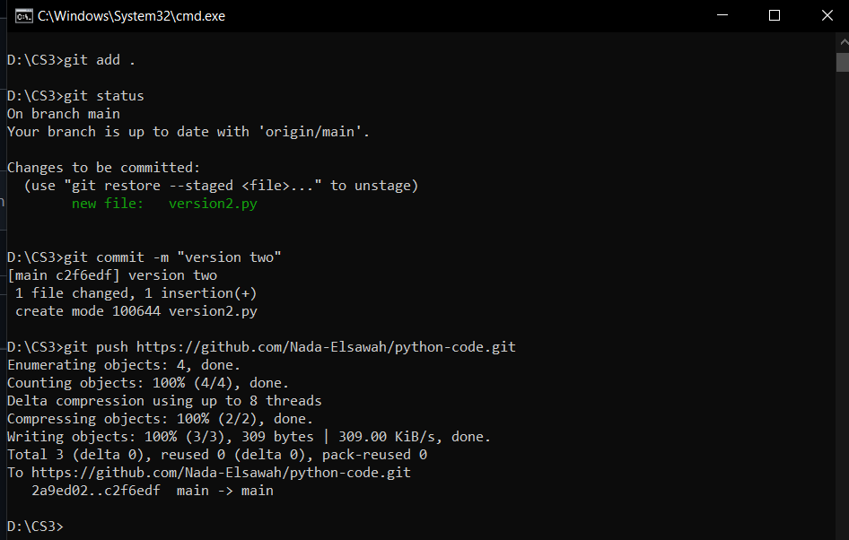
git init command used only one time in the repo
1
2
3
4

Slide 26
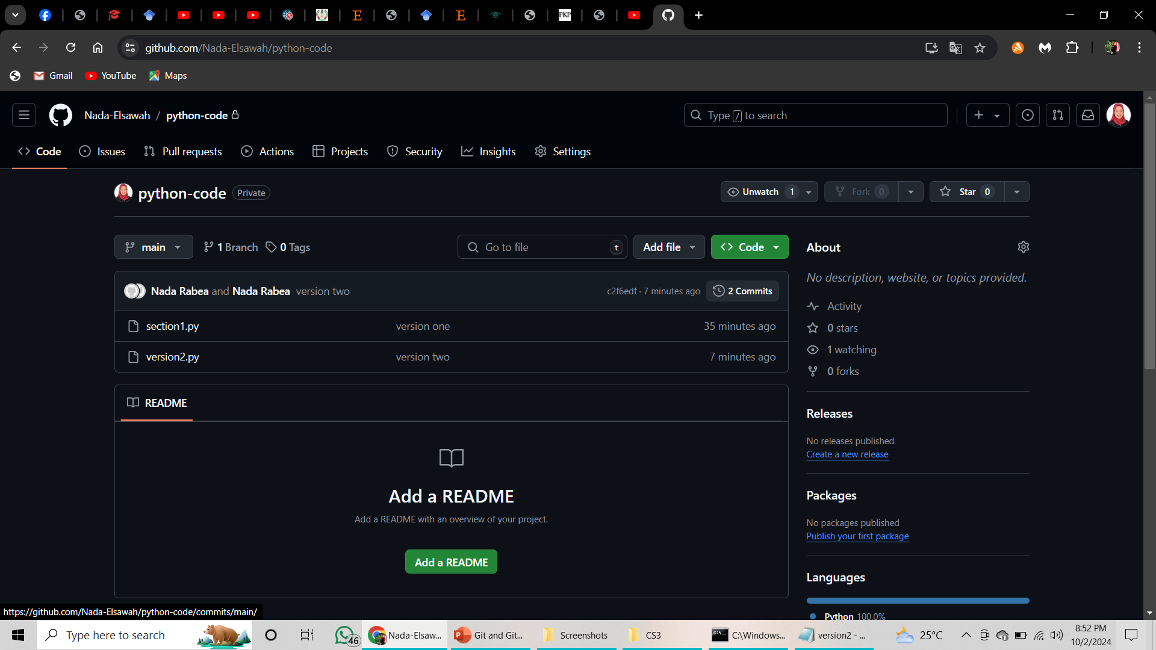
Now we upload the new file and make two commits

Slide 27
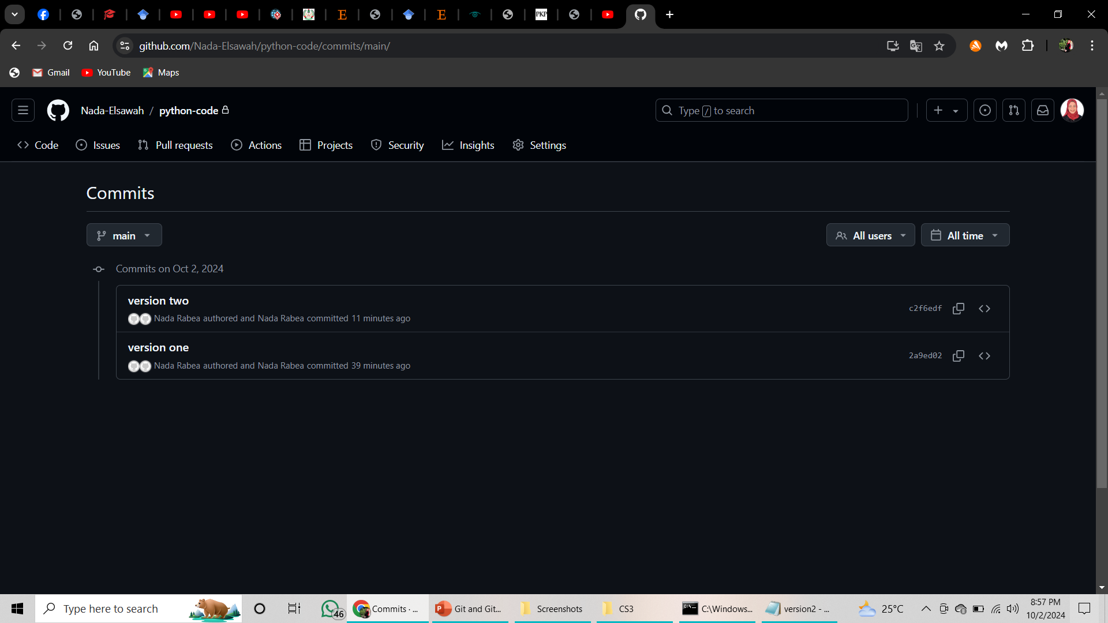
You can here see the two commits

